Slide 1
Procurement Institutions and Essential drug Supply in Low and Middle-Income Countries
Presenter: Lucy Xiaolu Wang, Ph.D.
(UMass Amherst; Max Planck Institute for
Innovation and Competition; CCHE Canada)
coauthor: Nahim Bin Zahur (Queen’s U)

Slide 2
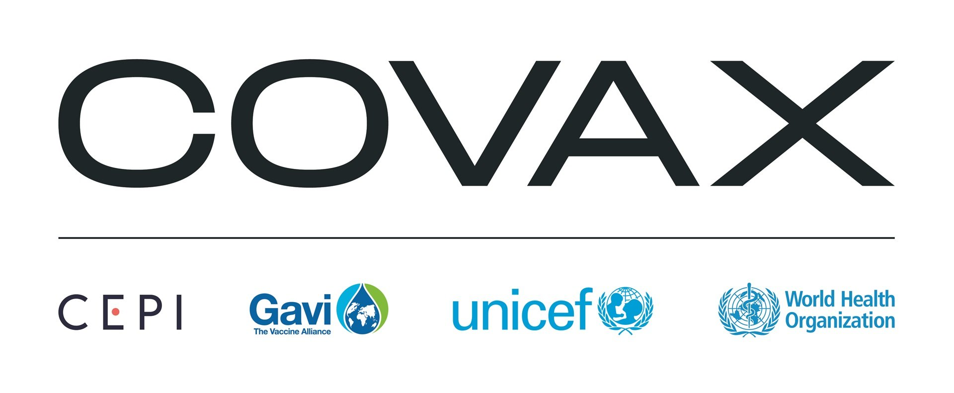
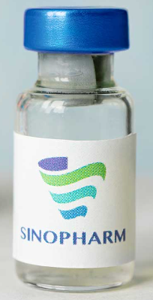
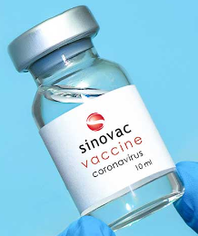
Institutional Failures in Access to Medicines
Slow diffusion of drugs to low and middle-income countries (LMIC)
Multiple barriers to drug diffusion
Weak commercial incentives to invest and sell in LMIC
Supply chain bottlenecks & lack production capacity limits
Intellectual property (IP): patents, exclusivity, trade secrets
Procurement institutions play a big role in LMIC drug supply
But we know do not know enough about the efficiency and tradeoffs
A need for novel procurement and delivery institutions
E.g., COVAX vs bilateral vaccine deals for LMIC

Slide 3
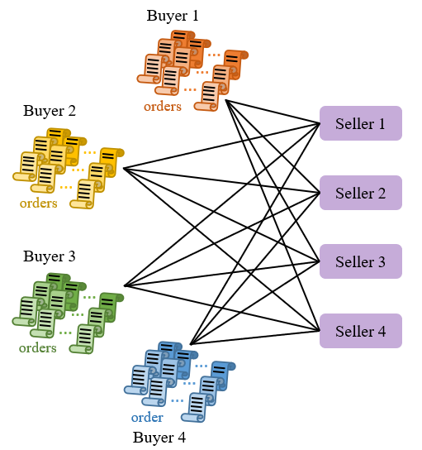
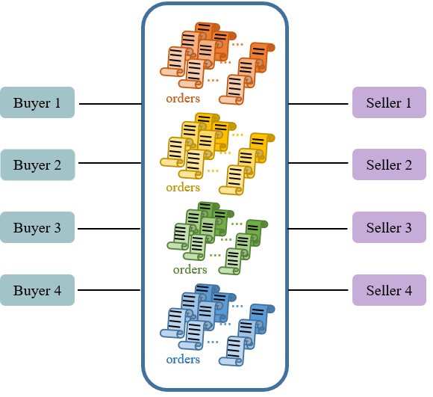
Decentralized vs pooled procurement institution
Decentralized procurement
Pooled procurement
We focus on intl. pooled procurement institutions:
pooled procurement mechanism (PPM), United Nations (UN)

Slide 4
Question: How do procurement institutions affect price and non-price outcomes in LMIC drug supply?
Analyze effects on multiple key outcomes: price, delays, procurement lead time, and drug choices
Examine heterogeneity of procurement institutions regarding the age of drugs, market concentration, buyer size, and patent status
Understanding the relative merits of procurement and IP licensing institution (i.e., Medicines Patent Pool) across drug types
Literature: 1) centralized procurement; 2) global drug diffusion. Contribution: various institutions, non-price outcomes; institutions tackle IP & non-IP barriers

Slide 5
Background: what are the procurement institutions?
Direct from Manufacturers: decentralized
Central Medical Stores (CMS): pooling orders within-country: e.g., South Africa, Senegal, Cameroon, Tunisia, Namibia, Mauritania, …
Global Fund’s Pooled Procurement Mechanism (PPM): pooling orders across countries (takes pooling to the limit; with integrated payment system)
United Nations (UN): pooling orders across countries (inter-governmental)
Others: non-profit procurement/development organizations, private wholesalers, international health NGOs

Slide 6
Data: drugs supplied, suppliers, categories, & others
LMIC drug procurement from Global Fund, 2007-2017
Price, quantity, scheduled and actual delivery dates, order date
Procurement agencies, manufacturer, destination countries
All purchases are Global Fund-funded: comparable in funding source
Drug-level: disease categories, approval year, and drug classes
WHO, US FDA, and extensive medical literature search
Drug-country-year: patent status & IP licensing institution
MedsPaL, Pat-Informed, DrugPatentWatch; Medicines Patent Pool
Country-year level characteristics: demographics, income, disease portfolios, within-country institutional features, etc.
World Bank, UN, Institute for Health Metrics & Evaluations

Slide 7
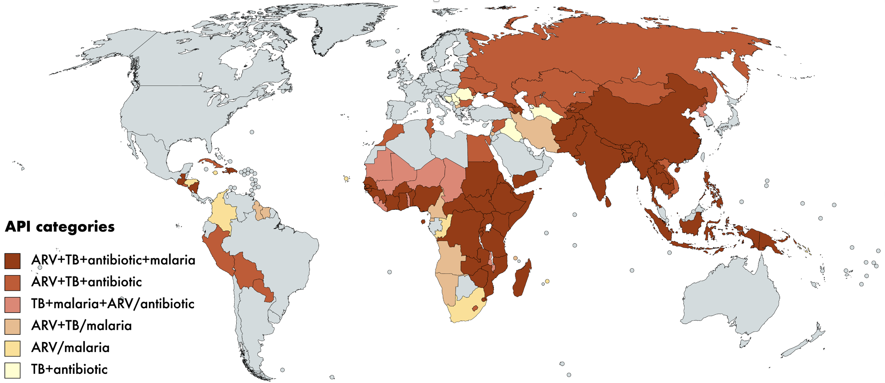
Descriptives: coverage on drug categories
83 drugs (APIs) & 191 drug products (API-strengths) supplied to 106 LMIC 2007-2017

Slide 8
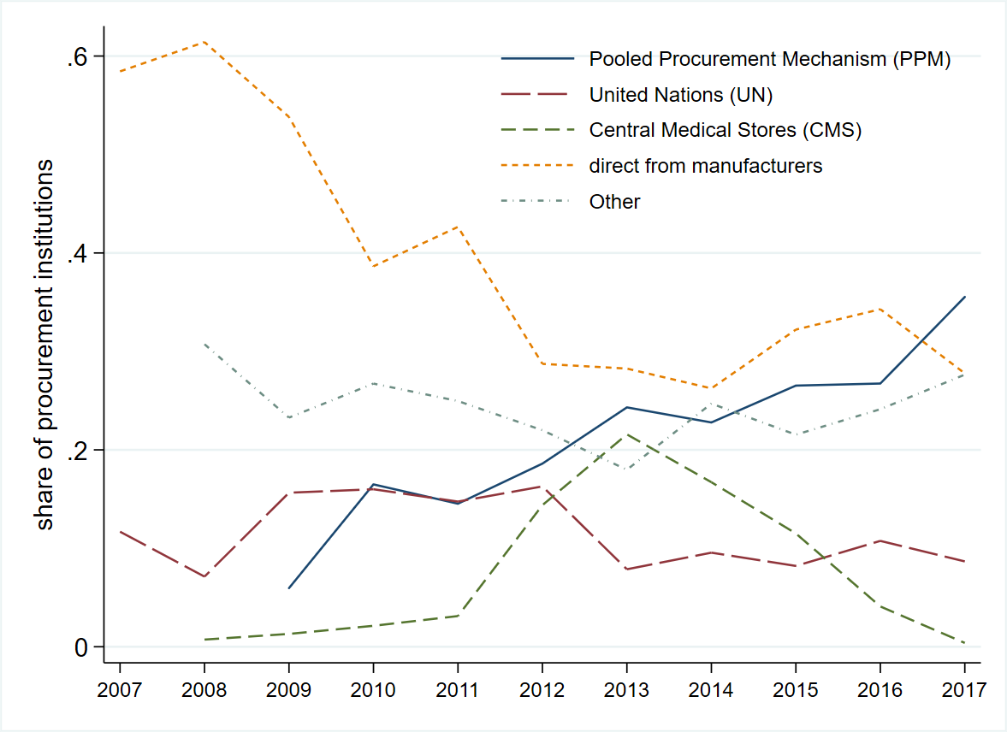
Trends in procurement institution representation (%)

Slide 9
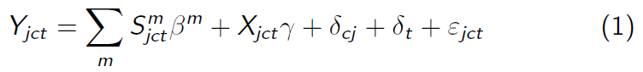
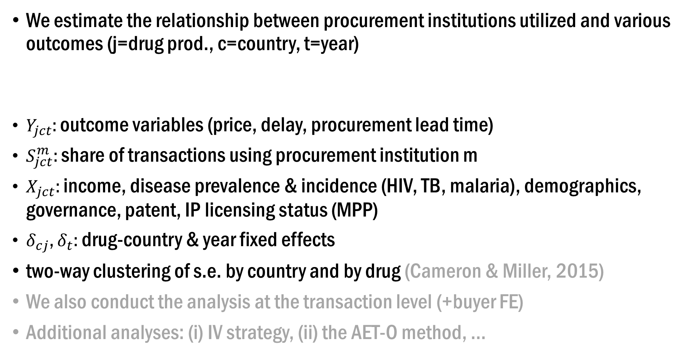
Empirical framework
We estimate the relationship between procurement institutions utilized and various outcomes (j=drug prod., c=country, t=year)
$Y_{jct}$: outcome variables (price, delay, procurement lead time)
$S_{jct}^{m}$: share of transactions using procurement institution m
$X_{jct}$: income, disease prevalence & incidence (HIV, TB, malaria), demographics, governance, patent, IP licensing status (MPP)
$δ_{cj}$, $δ_{t}$: drug-country & year fixed effects
two-way clustering of s.e. by country and by drug (Cameron & Miller, 2015)
We also conduct the analysis at the transaction level (+buyer FE)
Additional analyses: (i) IV strategy, (ii) the AET-O method, ...

Slide 10
Results: procurement institution and prices
Panel-level: Prices lower with cross-country pooling (30-38% for PPM, 23% for UN)
Transaction-level: Transaction-level prices lower with cross-country pooling (17-20% for PPM, 10-13% for UN); significant but very small effect of buying in bulk
Cross-country pooling reduces prices more for older drugs, but has similar price effects by patent status (vs. Medicines Patent Pool reduces prices for patented drugs)
Pool internationally (cross-country) is most effective when:
(i) market is more concentrated (ii) buyers are small
Pool within-a-country is most effective when:
(i) market is less concentrated (ii) buyers are large

Slide 11
Procurement institution and non-price outcomes
Stockout of essential drugs is a major problem in LMICs (e.g., Gallien et al., 2017; Fitzpatrick, 2022)
Stockout risk can be increased by either lengthy procurement lead time or unexpected delays (or both)
Procurement lead time: number of days between date of order and date of delivery
Delay: indicates whether the actual delivery date was after the scheduled delivery date
We test how these delivery outcomes vary by procurement institutions
Although shipments are 26-28% less likely to be delayed, procurement lead time is substantially longer for PPM (by 105 - 114 days); not so for CMS (transaction level)
No significant differences in % of patented or older drugs purchased

Slide 12
Discussion of trade-offs and potential mechanisms
Why do not all countries use intl. pooling (PPM/UN)?
Not all products are available via intl. pooling each year
PPM coverage: 80+% for ARVs and 30% for non-ARVs
UN coverage: about 60% for ARVs and 20% for non-ARVs
PPM requires advanced planning that differs by product, with the lead time often longer for low-volume products
Some countries may want to develop their own domestic procurement institutions and enhance supply-chain management
supply chain security during emergencies or political disruption

Slide 13
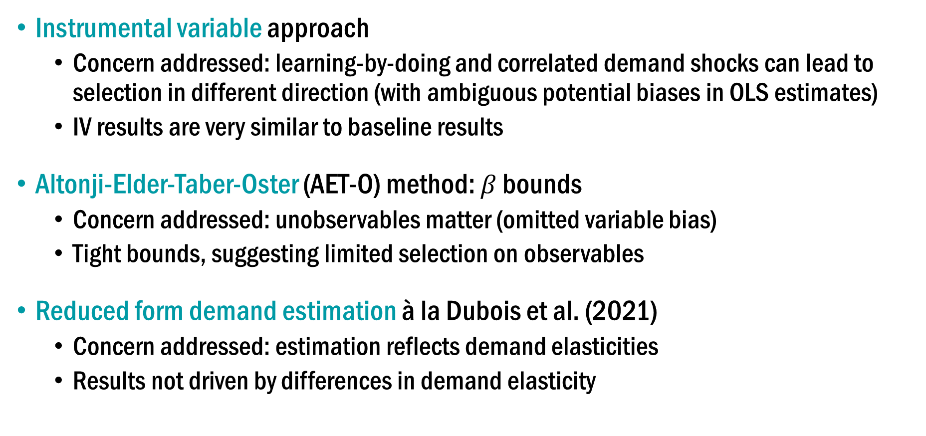
Other empirical strategies to strengthen the causality
Instrumental variable approach
Concern addressed: learning-by-doing and correlated demand shocks can lead to selection in different direction (with ambiguous potential biases in OLS estimates)
IV results are very similar to baseline results
Altonji-Elder-Taber-Oster (AET-O) method: $β$ bounds
Concern addressed: unobservables matter (omitted variable bias)
Tight bounds, suggesting limited selection on observables
Reduced form demand estimation à la Dubois et al. (2021)
Concern addressed: estimation reflects demand elasticities
Results not driven by differences in demand elasticity

Slide 14
Other institutional factors & management practices
The estimates on procurement institutions remain similar when we further account for other institutional aspects:
the role of other large buyers (i.e., PEPFAR)
ceiling or reference prices provided by CHAI
Procurement institutions are associated with lower variability in manufacturer orders
Other market-level analyses: comparison of in-sample prices to median prices in intl. guidelines and supplier pool coverage
Examine a set of management variables: tiered pricing, advanced payment practices, drug subsamples, start-up effect of PPM, ...
Results are robust to other definitions of the “other” group
Other results: heterogeneity by drug categories; control grantee types; …

Slide 15
Conclusion & Discussion
Pooled institutions lower drug prices, and potentially reduce delays at the cost of longer procurement lead times
Pooled procurement institutions are overall effective in facilitating drug supply, esp. older generation drugs
No one-size-fits-all institutions; countries may consider using a mix of institutions for various scenarios (regular vs emergency)
Paper link:
Wang & Zahur (2023). Procurement Institutions and Essential Drug Supply in Low and Middle-Income Countries. https://ssrn.com/abstract=3926761
A related work: Wang, L.X. (2022). Global Drug Diffusion and Innovation with the Medicines Patent Pool.
Journal of Health Economics, 85. https://doi.org/10.1016/j.jhealeco.2022.102671

Slide 16
Procurement Institutions and Essential Drug Supply in Low and Middle-Income Countries
Thank you!
Contact: Lucy Xiaolu Wang (UMass Amherst; Max Planck Institute for Innovation and Competition; Canadian Centre for Health Economics; xiaoluwang@umass.edu)
Coauthor: Nahim Bin Zahur (Queen’s University; nahim.zahur@queensu.ca)
Wang & Zahur (2023). Procurement Institutions and Essential Drug Supply in Low and Middle-Income Countries. https://ssrn.com/abstract=3926761

